Slide 1
Physician agency, consumerism, and the consumption of lower-limb MRI scans
Chernew et al.
Presented by Martha Wetzel

Slide 2
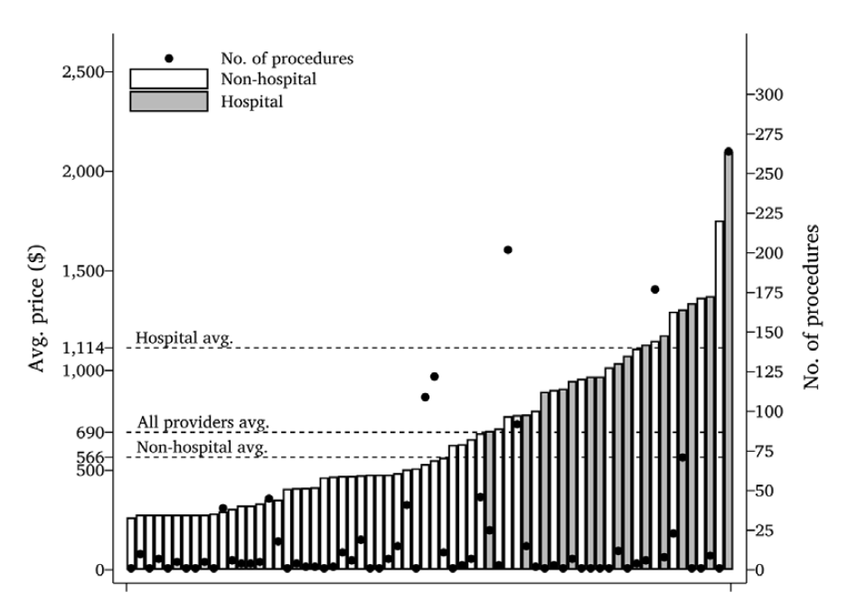
Motivation
High variation in cost of lower-limb MRIs
Very little variation in quality
Price theory predictions are not born out by the empirical literature

Slide 3
Research Question
Describe/identify
Money left on the table
Factors associated with cost of care
Referral patterns of orthopedic surgeons
Differences in referral patterns of vertically-integrated orthopedic surgeons vs. independent practitioners

Slide 4
Contribution
Provides a lower bound on the estimate of the influence of physician preferences on where patients receive care
Demonstrates the importance of explicitly accounting for physician recommendations in patient choice models
Notes:
Why lower bound:
Planned in advance
Undifferentiated in quality
Patients have a price transparency tool

Slide 5
Preview of Findings
Patients bypass cheaper, closer options
Appears to be driven by physician effects
The patients of vertically integrated physicians go to more expensive facilities

Slide 6
Data
Insurance claims data from a large national insurer
Lower limb MRIs
Orthopedist seen in the three months preceding the MRI
SK&A provider data
Usage data on cost compare tool
Notes:
SK&A is an IQVIA product and has been renamed OneKey

Slide 7
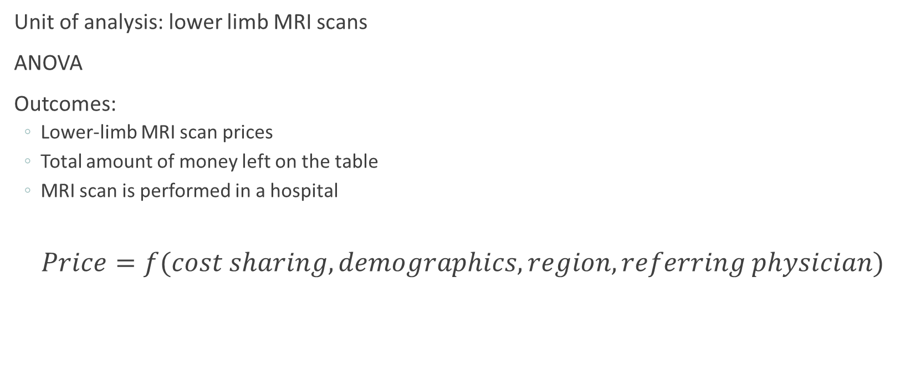
Analysis
Unit of analysis: lower limb MRI scans
ANOVA
Outcomes:
Lower-limb MRI scan prices
Total amount of money left on the table
MRI scan is performed in a hospital
$$Price=f(cost sharing, demographics, region, referring physician)$$
Notes:
Predictors in ANOVA: a binary indicator of whether patients faced cost-sharing for their scan, patient demographic characteristics (year of birth, Charlson comorbidity score, race, and sex), fixed-effects for patients’ home HRR, and fixed-effects for patients’ referring physicians

Slide 8
Threats
Tons of provider fixed effects
Compare results with random assignment of patients to physicians in their HRR
Referrals not directly observed
Doctor advice
Office staff advice
Patient preference clustering

Slide 9
Results Summary
On average, there were six lower-priced MRI providers closer to the patient’s home than the location where the patient received care
If patients used the cheapest provider within the same distance they actually travelled, would save:
$84.37 in patient out-of-pocket spending
$220.49 in insurer spending
Notes:
As we illustrate in Appendix Table 1, controlling for patient characteristics and patient HRR fixedeffects, patients with price exposure (those below theirout-of-pocket maximum at the time their scan was taken)had slightly more expensive MRI scans than patients whohad no price exposure.

Slide 10
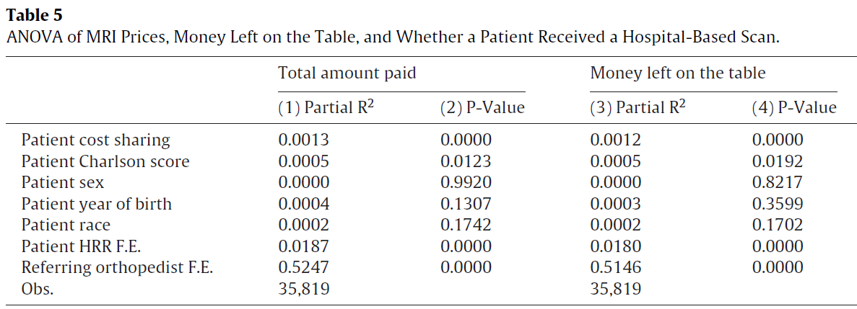
Results

Slide 11
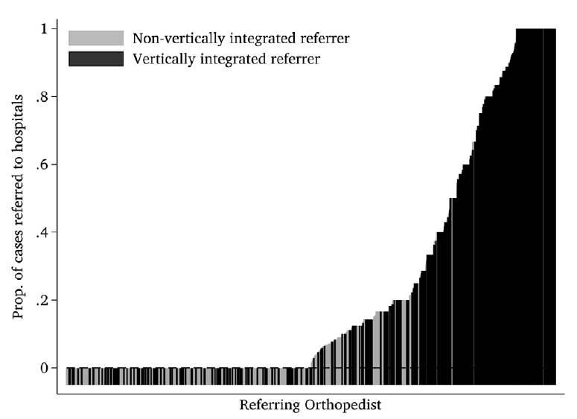
Results: Vertical Integration
Notes:
ThatFig. 3. Rate at Which Referring Physicians Send Patients for Hospital-Based MRIs.Notes: Each bar is an orthopedic surgeon. The sample of referrers is lim-ited to the same set used for the analysis in Table 5 (i.e. orthopedists whomade at least five referrals in 2013, excluding singleton patient HRRs).The bar height indicates the proportion of cases an individual orthope-dist refers her patients to a hospital. Black bars indicate referrers who arevertically-integrated with a hospital. Grey bars indicate referrers who arenot vertically-integrated.

Slide 12
Discussion
“These results indicate the need for insurers to work with physicians themselves, rather than exclusively loading incentives on patients, to reduce spending.”
Feasibility?
Does it matter that referrals are not directly observed?

Slide 13
Further Research
“Patients with price exposure (those below their out-of-pocket maximum at the time their scan was taken) had slightly more expensive MRI scans than patients who had no price exposure”
Application to pain research

Slide 14
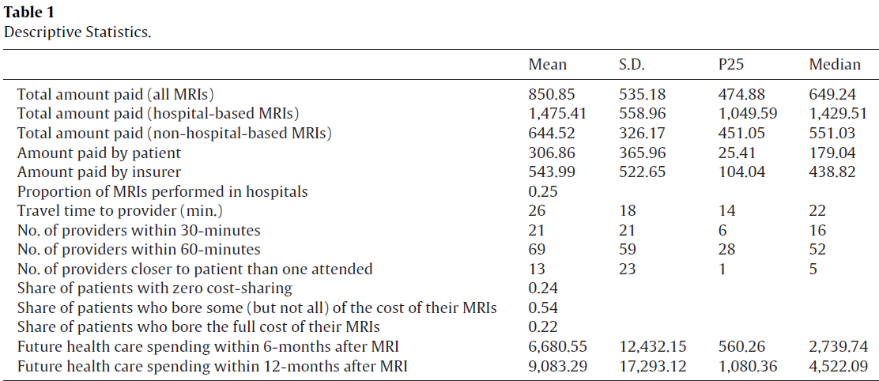
Descriptive Stats

